Slide 1

SIMPLE CORRELATION
By-
Saujanna Jafreen
Lecturer
Department of Natural Sciences

Slide 2
INTRODUCTION
When variables are found to be related, we often want to know how close the relationship is. The study of this relation is known as correlation analysis.
Simple correlation is denoted by r, which is called Pearson’s correlation coefficient or simple correlation coefficient.
The primary objective of correlation analysis is to measure the strength or degree of linear association between two or more variables.
Scatter plot is an essential and important first step in studying the association between two variables.

Slide 3
WHY USE CORRELATION
We can use the correlation to test is there any linear relationship between the variables or not. To quantify the strength of the relationship, we can calculate the correlation coefficient (r).

Slide 4
PROPERTIES OF CORRELATION COEFFICIENT
Ranges of r always lie between -1 to +1.
-1 ≤ r ≤ +1
Correlation coefficient (r)is a dimension less property.
Correlation coefficient (r) is a symmetric measure.
Correlation coefficient (r) will be positive or negative depending on whether the sign of the numerator of the formula is positive or negative.
Correlation coefficient (r) is independent of origin and scale of measurement.

Slide 5
TYPES OF CORRELATION
Positive Correlation: If any variable increase in proportion to other variable, then it’s call Positive Correlation.
Negative Correlation: If any variable decrease in proportion to other variable, then it’s call Negative Correlation.

Slide 6
EXAMPLE
As a student's study time increases, so his exam marks increases. So correlation between study time and exam marks is positive correlation .
As weather gets colder, air conditioning costs decrease. So correlation between temperature and costs of ac is negative correlation.

Slide 7
CORRELATION IN DIFFERENT CASES
Income and expenditure of a family
Intelligence and the value of dress won
Idle time of a machine and the value of production.
Study time and exam marks
Amount of money and intelligence
No of books and no of dress
Personality and body fitness
Beauty and attraction
Etc.

Slide 8
INTERPRETATION
r= +1 indicates, X and Y are perfectly related in a positive linear sense.
r= -1 indicates, X and Y are perfectly related in a negative linear sense.
r= 0 indicates , there is no relation between X and Y.
r= close to +1 indicates, a strong linear relationship in a positive sense between X and Y
r= close to -1 indicates, a strong linear relationship in a negative sense between X and Y

Slide 9
DIFFERENT TYPES OF CORRELATION
-1 ≤ r ≤ +1
0.1-0.3 are Weak Relation
0.4-0.6 are Moderate Relation
0.7-0.9 are Strong Relation
1 is perfect Relation
Same thing happens for negative values.

Slide 10
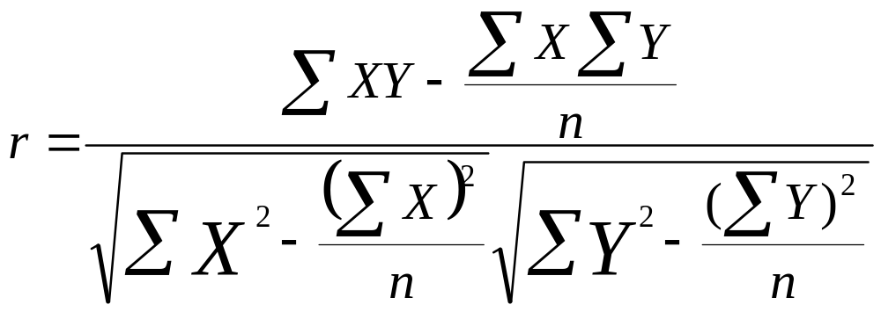
FORMULA

Slide 11
PROBLEM 1
Suppose ,The local ice cream shop keeps track of how much ice cream they sell versus the temperature on that day, here are their figures for the last 5 days:
Days | Temperature °C (X) | Ice Cream Sales(Y) | x² | y² | XY
01. | 28.4° | 1500 | 806.56 | 2250000 | 42600
02. | 25.1° | 1200 | 630.01 | 1440000 | 30120
03. | 31.2° | 1700 | 973.44 | 2890000 | 53040
04. | 30.4° | 1550 | 924.16 | 2402500 | 47120
05. | 33.6° | 2000 | 1128.96 | 4000000 | 67200
Total= | 148.7 | 7950 | 4463.13 | 12982500 | 240080

Slide 12
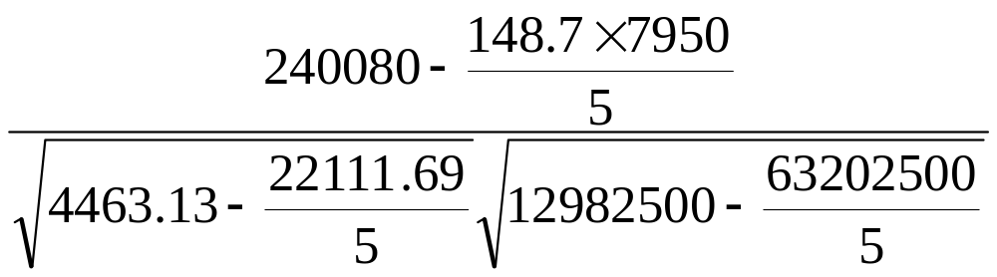
SOLUTION
r =
= 0.977
Interpretation:
We conclude that, there exists a strong positive linear relationship between the Temperature and Ice Cream Sales.

Slide 13
PROBLEM 2
Let us consider, the data on sales volume presented in table 1 compute the correlation coefficient between the year of experience of the sales persons(X) and the annual sales volume (Y).
calculate r.

Slide 14
SOLUTION
Sales person | X | Y | XY | X2 | Y2
1 | 1 | 80 | 80 | 1 | 6400
2 | 3 | 97 | 291 | 9 | 9409
3 | 4 | 92 | 368 | 16 | 8464
4 | 4 | 102 | 408 | 16 | 10404
5 | 6 | 103 | 618 | 36 | 10609
6 | 8 | 111 | 888 | 64 | 12321
7 | 10 | 119 | 1190 | 100 | 14161
8 | 10 | 123 | 1230 | 100 | 15129
9 | 11 | 117 | 1287 | 121 | 13689
10 | 13 | 136 | 1768 | 169 | 18496
Totals | 70 | 1080 | 8128 | 632 | 119082

Slide 15
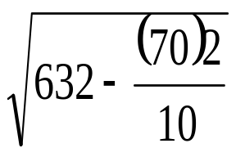
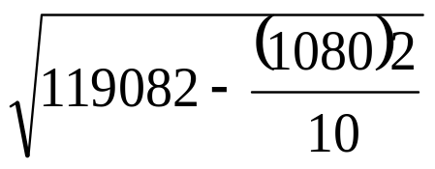
70*1080
8128 -
10
r=
= 0.96
Interpretation:
We conclude that, there exists a strong positive correlation between the years of experience of the salesman and the annual sales volume of the departmental store.

Slide 16
ADVANTAGES & DISADVANTAGES OF CORRELATION
Advantages:
Correlation research allows researchers to collect much more data than experiments.
Correlation allows researchers to determine the strength and direction of a relationship .
Disadvantages:
Correlation research only uncovers a relationship; it cannot provide a conclusive reason for why there's a relationship.
The most used correlation coefficients only measure linear relationship.

Slide 17
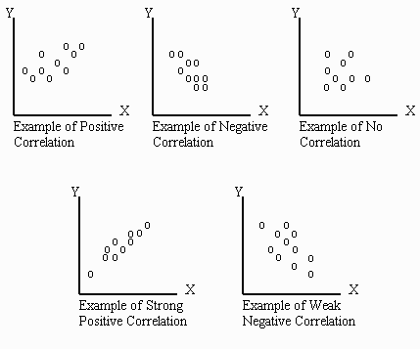
SCATTER PLOT IN CORRELATION
Scatter plots are a useful means of getting a better understanding of your data.

Slide 18
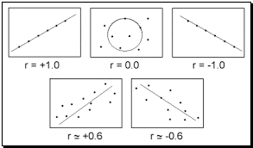

Slide 19
IMPORTANCE OF SCATTER PLOT
Scatter plots are important in studying correlation .They can show the extent of correlation, between the values of observed quantities (called variables).
If no correlation exists between the variables, the points appear randomly scattered on the coordinate plane. If a large correlation exists, the points concentrate near a straight line.
Scatter plots are useful data visualization tools for illustrating a trend.

Slide 20


